Slide 1


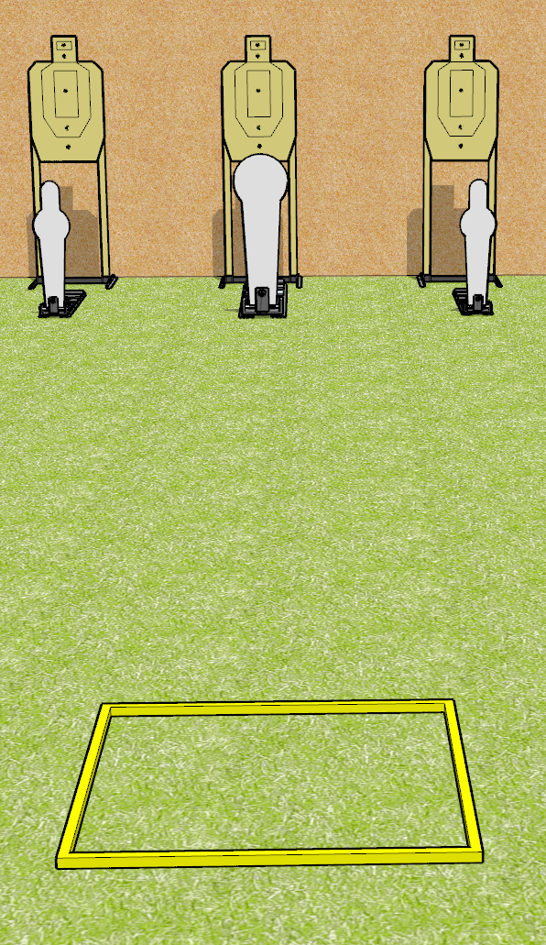
 | Dothan Gun Club – USPSA Match A Simple Speed Shoot Course Designer : Drew Coleman
Round Count 9 rounds 3 USPSA targets 2 mini poppers, 1 colt popper
Equipment List Shooting box

Slide 2
A Simple Speed Shoot
Written Stage Briefing
A Simple Speed Shoot is a 9 round, 45 point, Comstock speed shoot. There are 3 USPSA targets, 2 mini poppers, and 1 colt poppers. The best 2 hits on paper will score, and steel must fall to score. The start signal is audible.
Handgun start position is facing uprange, toes touching rear of box, wrists above shoulders. Handgun is loaded and holstered.
PCC start position is in shooting box, stock on belt. Carbine is loaded with safety on.
On start signal, engage EITHER the mini poppers, OR the Colt popper, perform a mandatory reload, and engage the remaining array. The paper targets may be engaged at any time.

Slide 3
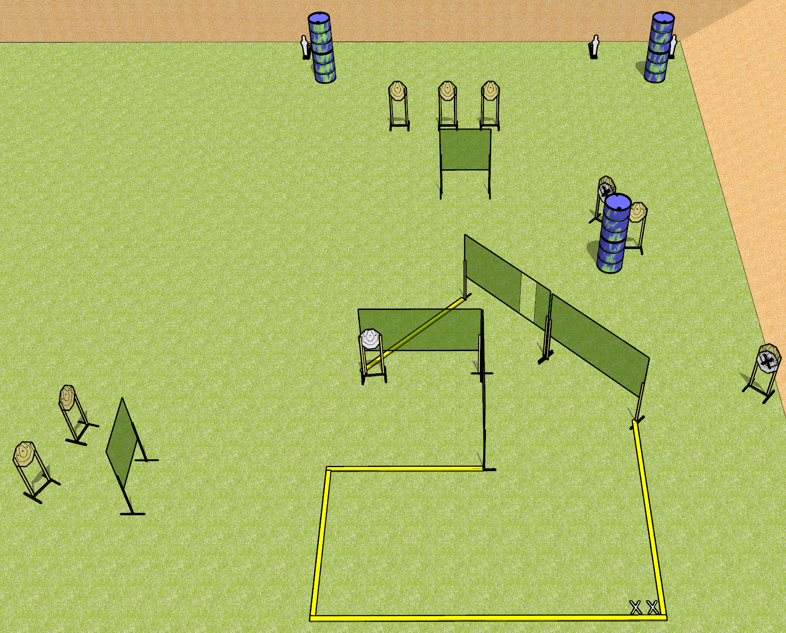
 | Dothan Gun Club – USPSA Match Send It Course Designer : Drew Coleman
Round Count 19 rounds 8 ISPC 3 mini poppers
Equipment List 10 wall feet

Slide 4
Send It
Written Stage Briefing
Send It is a 19 round, 95 point, Comstock course of fire. There are 8 IPSC targets and 3 mini poppers. The best 2 hits on paper will score, and steel must fall to score. The start signal is audible.
Handgun start position is feet on X’s, heels touching rear fault line. Handgun is loaded and holstered.
PCC start position is feet on X’s, heels touching rear fault line, stock on belt. Carbine is loaded with safety on.
On start signal, engage targets as they become available from within the shooting area.

Slide 5
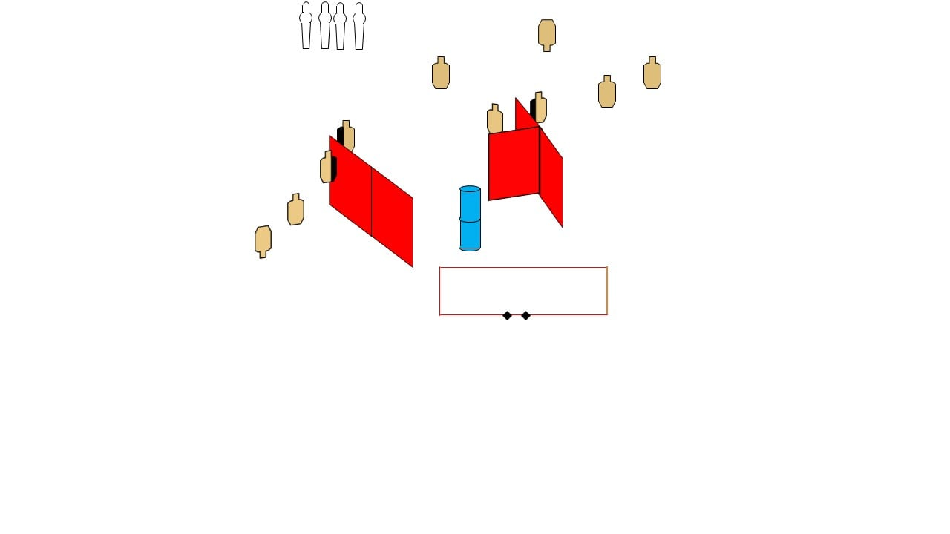
 | Dothan Gun Club – USPSA Match Rainy Day Course Designer : Danny Minter (Facebook)
Round Count 24 rounds 4 poppers 10 USPSA
Equipment List 2 medium fault lines 6 wall feet

Slide 6
Rainy Day
Written Stage Briefing
Rainy Day is a 24 round, 120 point, Comstock course of fire. There are 10 USPSA targets and 4 poppers. The best 2 hits on paper will score, and steel must fall to score. The start signal is audible.
Handgun start position is both feet on X’s, wrists below belt. Handgun is loaded and holstered.
PCC start position is both feet on X’s, stock on belt. Carbine is loaded with safety on.
On start signal engage targets as they become available from within the shooting.

Slide 7
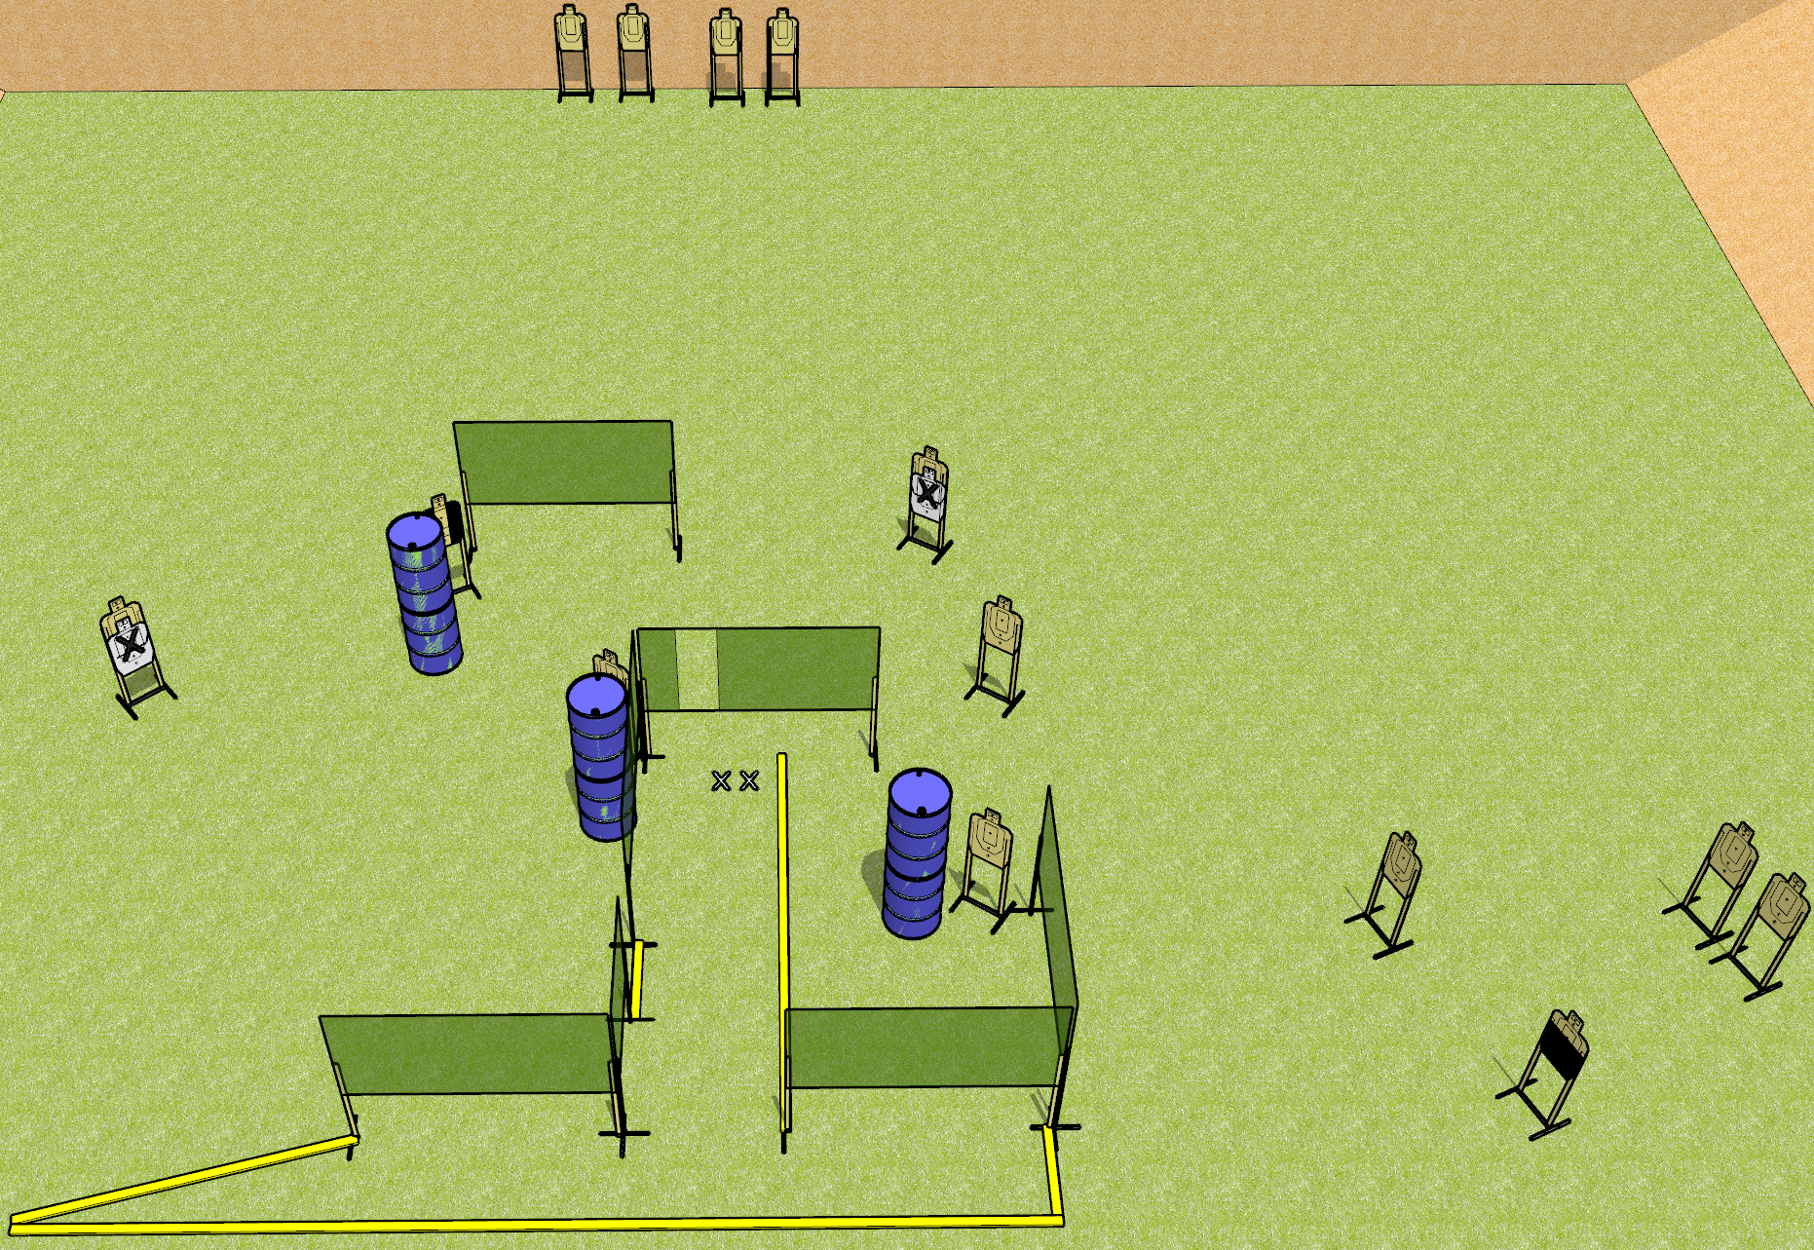
 | Dothan Gun Club – USPSA Match Use the Big Bay Course Designer : Drew Coleman
Round Count 28 rounds 14 USPSA targets
Equipment List 11 wall feet 2 3’ fault lines Use 10 foot for the far left angled part.

Slide 8
Use the Big Bay
Written Stage Briefing
Use the Big Bay is a 28 round, 140 point, Comstock course of fire. There are 14 USPSA targets. The best 2 hits on paper will score, and steel must fall to score. The start signal is audible.
Handgun start position is both feet on X’s, wrists below belt. Handgun is loaded and holstered.
PCC start position is both feet on X’s, stock on belt. Loaded carbine is held with both hands, safety on.
On start signal, engage targets as they become available from within the shooting area.

Slide 9
 | Dothan Gun Club – USPSA Match Shoot House Course Designer : Does anyone read these things?
Round Count
Equipment List

Slide 10
Shoot House
Written Stage Briefing

